Slide 1
FISCAL ANNUAL PLANNING PROJECT PROPOSAL
Here is where your presentation begins

Slide 2
Projekt bemutatása
Mi a projekt célja.
A Robi & Ricsi & Norbi Kutyamenhely egy teljes körű webalkalmazás, amely segíti az örökbefogadásra váró kutyák nyilvántartását, az érdeklődők tájékoztatását, az örökbefogadási kérelmek kezelését és az adminisztrátori munkát.
Cél | Megkönnyíteni a kutyamenhely működését és az örökbefogadási folyamatot
Célcsoport | Örökbefogadni vágyók, menhely dolgozói, adminisztrátorok
Platform | Böngészőalapú webalkalmazás, reszponzív dizájnnal
Fejlesztés | 2025/2026-os tanév, csapatos iskola projekt

Slide 3

Használt technológiák
Frontend: HTML5 + CSS3, JavaScript, Bootstrap4
Backend: Node.js, Npm modules
Adatbázis: MySQL, phpMyAdmin,
Eszközök: Vs Code, XAMPP, Github, PostMan,

Slide 4
01
Szentpáli Richárd

Slide 5
02
Tóth Róbert

Slide 6
03
Ács Norbert

Slide 7
OBJECTIVES
OUR AIM
THE GOAL
An aim in a corporate context is a goal or desired result that the organization seeks to achieve. The aim should be clear and achievable, and often serves as the basis for further planning actions inside the organization
Goals inside a company are usually specific and measurable, with clearly defined deadlines and outcomes. The company’s goals help focus the actions of the organization and ensure resources are used effectively

Slide 8
RESOURCES
HUMAN
RESOURCES
FINANCIAL RESOURCES
PHYSICAL RESOURCES
The project team is responsible for the successful execution of the project. Our team is composed of experienced professionals with the necessary skills and expertise to complete the project on time and within budget
Our project budget is $100,000. This budget includes all expenses associated with the project, including salaries and equipment. We have allocated these resources to ensure that we are able to complete the project within budget
Our project requires a number of specialized pieces of equipment. We will be using [insert equipment and their functions]. All equipment is in good working condition and has been tested and calibrated prior to use

Slide 9
BUDGET
SOURCES OF FUNDING
PERSONNEL COSTS
Funding for a company can come from personal savings or investments, bank loans and other loan options, venture capital and angel investors, grants, competitions or programs, crowdfunding…
Personnel costs refer to the expenses incurred in hiring, training and retaining staff for a company. This can include salaries, bonuses, benefits and other payroll-related costs
EQUIPMENT AND MATERIALS
TRAVEL AND MISCELLANEOUS
Equipment and materials costs refer to all the expenses related to the purchasing, maintenance and upkeep of any physical items used in production or other business processes inside the company
Travel and miscellaneous costs refer to expenses related to any travel-related activities, such as conferences, trainings or business trips. It may also include office supplies, communications services, licenses and other miscellaneous expenses

Slide 10
SOLUTIONS
SOLUTION 1
SOLUTION 2
SOLUTION 3
Implementing a new CRM (Customer Relationship Management) system to improve customer data management and sales tracking
Outsourcing specific business functions (such as accounting or IT) to a third-party provider to reduce costs and increase time efficiency
Launching an e-commerce platform to expand the reach of the business and increase online sales
SOLUTION 4
SOLUTION 5
SOLUTION 6
Developing a new product or service to diversify the business and increase the revenue streams
Implementing a cost-saving initiative, such as energy-efficient practices or process automation, to reduce expenses
Establishing strategic partnerships with other businesses to gain access to new markets or
innovative technologies

Slide 11
$500,000
200 UNITS
25%
Net profit of the project
Break-even point
Market share in the industry

Slide 12
10 MILLION
First-year revenue of the project

Slide 13
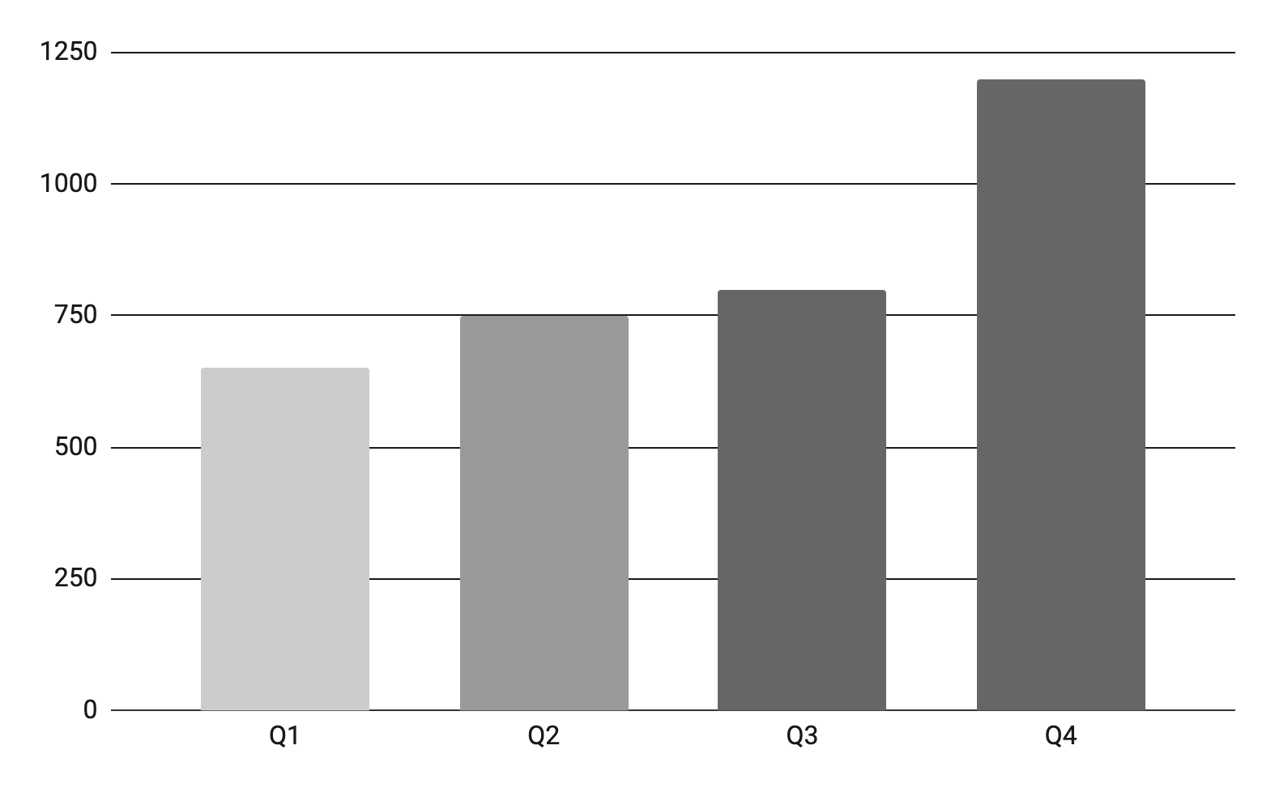
PROJECT DATA
BENEFITS OF USING GRAPHS
Graphs in project proposals offer visual organization, enabling clear presentation of information in a structured format. They enhance the visual appeal, facilitate data comparison and improve overall clarity and professionalism of your project proposal
Follow the link in the graph to modify its data and then paste the new one here. For more info, click here

Slide 14
PROJECT ACTIVITIES
ACTIVITY | START DATE | END DATE | RESOURCE | COST | REVENUE
MARKET RESEARCH | 1/1/20XX | 1/15/20XX | Market research firm | $20,000
PRODUCT DEVELOPMENT | 1/16/20XX | 6/30/20XX | R&D team | $200,000
BETA TESTING | 7/1/20XX | 8/15/20XX | Beta testers | $10,000
MARKETING CAMPAIGN | 1/1/20XX | 1/15/20XX | Advertising agency | $100,000
PRODUCT LAUNCH | 1/16/20XX | 6/30/20XX | Sales team | $50,000 | $500,000
POST-LAUNCH SUPPORT | 7/1/20XX | 8/15/20XX | Support team | $50,000 | $800,000

Slide 15

WHAT TO SHOW IN A MOCKUP
Product/website description: A brief overview of the product/website, including its key features, dimensions, and materials used
Features and benefits: A detailed explanation of the product's/website's features and how they will benefit the user
Technical specifications: A list of the product's/website's technical specifications, such as dimensions, weight, power requirements, connectivity options and hosting platform

Slide 16
PROJECT TIMELINE
Conduct market research and analyze the target audience to identify all the opportunities
Create the product or service by defining features, design, and also functionality
Test the product with a group of users to receive feedback and improve the product
Execute a marketing campaign to promote the product to the target audience
Release the product or service to the market with a comprehensive launch plan
Ease and provide customer support to ensure the full customer satisfaction
Explore opportunities for growth and expansion of the product or service
Continuously improve the product based on customer feedback and market trends

Slide 17
PROJECT ROADMAP
INITIATIVE | OBJECTIVE | J | F | M | A | M | J | J | A | S | O | N | D
MARKET RESEARCH | Increase brand awareness by 30% within the first year
PRODUCT DEVELOPMENT | Achieve a customer satisfaction rate of 90%
MARKETING CAMPAIGN | Increase revenue by 20% within the first year
PRODUCT LAUNCH | Achieve a customer satisfaction rate of 90% within the first year
EXPANSION | Reduce costs by 15% within the first year by expanding the product
PARTNERSHIP | Reach profitability within 18 months of launch

Slide 18



PHOTO SHOWCASE
A photo showcase can be a useful addition to a business project proposal as it can help to visually communicate the concept or idea being proposed

Slide 19
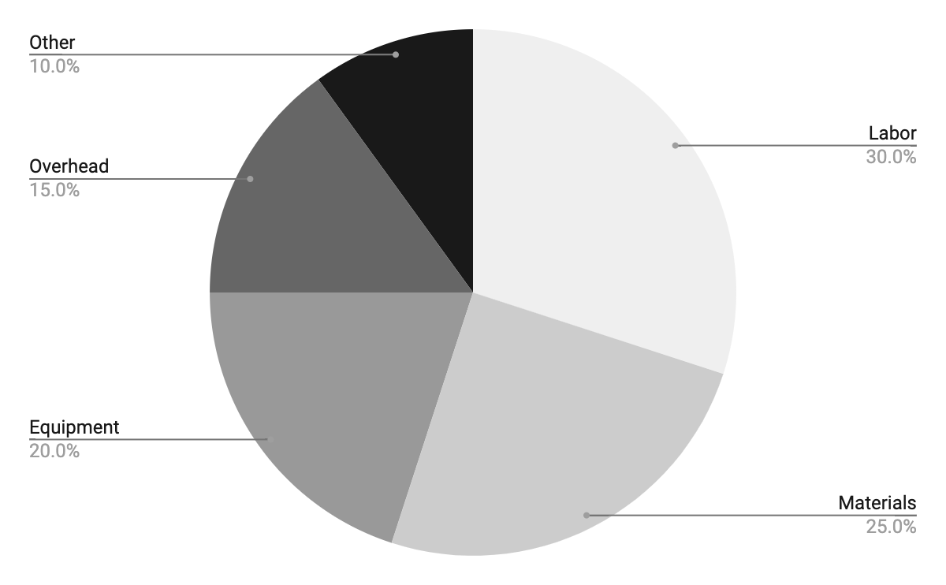
PROJECT EXPENSES
LABOR
MATERIALS
EQUIPMENT
OVERHEAD
OTHER
Follow the link in the graph to modify its data and then paste the new one here. For more info, click here

Slide 20
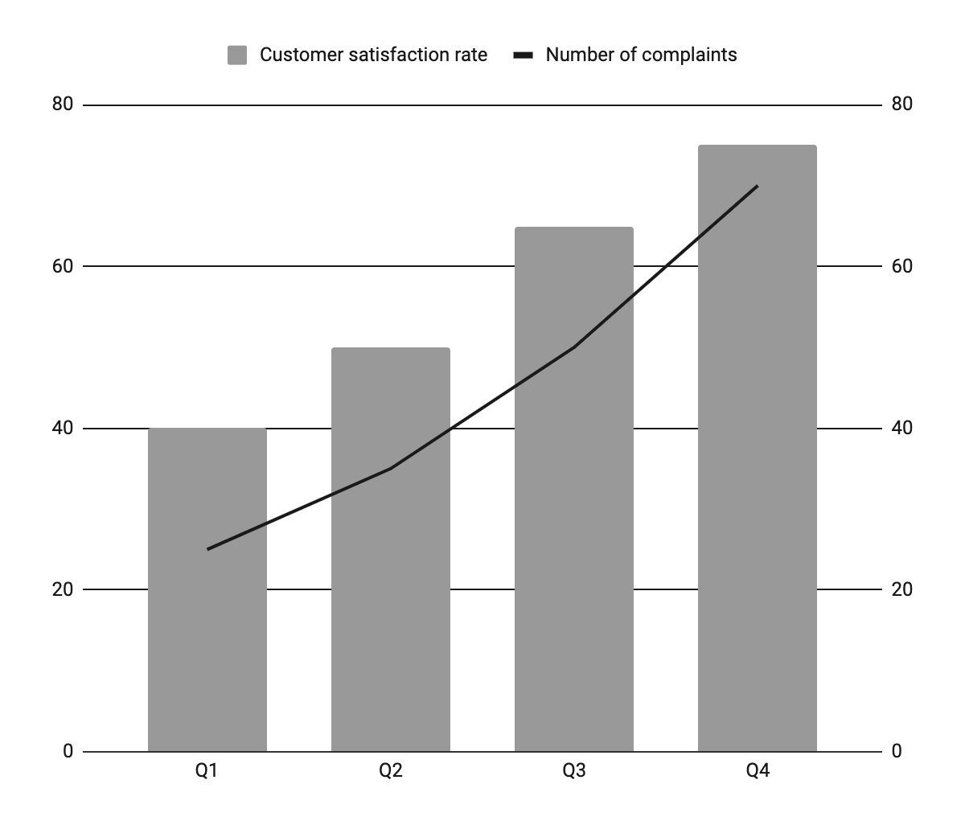
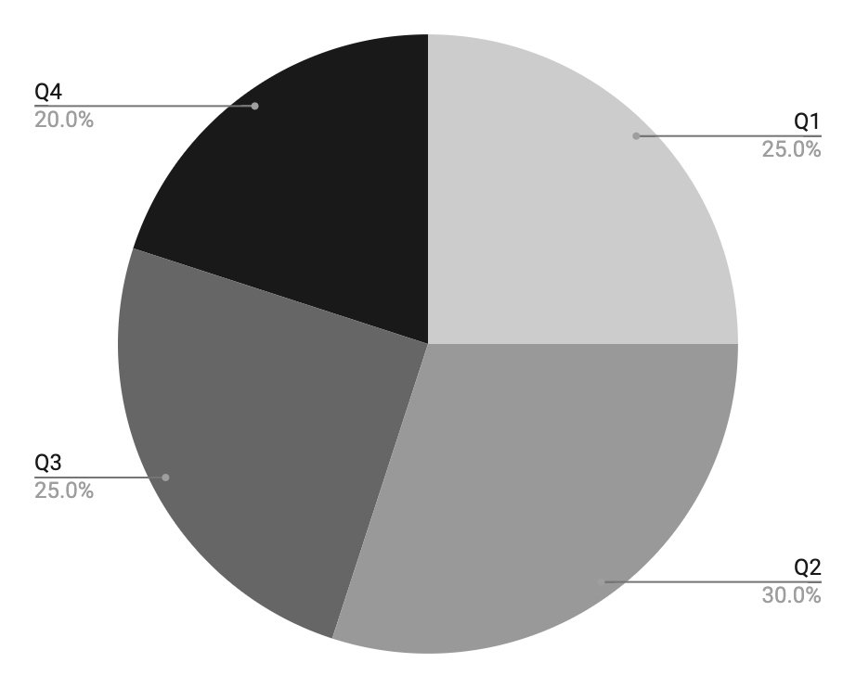
KPI DASHBOARD
RESOURCE | UTILIZATION RATE | COST PER UNIT
Labor | 85% | $50
Equipment | 70% | $100
Materials | 95% | $20
Rent | 90% | $1,000
Energy | 80% | $80
Software licenses | 80% | $200
Advertising | 60% | $500
120 U/DAY
2H
Output per worker
Time to complete a task
Follow the link in the graph to modify its data and then paste the new one here. For more info, click here

Slide 21
THANKS!
Do you have any questions?
youremail@freepik.com
+34 654 321 432
yourwebsite.com
Please keep this slide for attribution

Slide 22
ALTERNATIVE RESOURCES
Here’s an assortment of alternative resources whose style fits the one of this template:

Slide 23
RESOURCES
Did you like the resources in this template? Get them at these websites:
Vectors
Teamwork banner template
Teamwork instagram posts template
Landing page teamwork template
Photos
Male employee getting used to his new office job along with female colleagues
Smiley colleagues in the office during a meeting
Medium shot smiley colleagues at job
Beautiful women working together in a company
Icons
Icon Pack: Taxes | Filled

